Slide 1
Operations Research and Systems Analysis
Input-output analysis - basics

Slide 2
Introduction
Intuition: The economy is a network of industries that supply inputs to each other. If demand for cars rises, not only car production increases, but also steel, electricity, transport, and other upstream sectors.
or If final demand for the output of one industry increases (e.g., construction), how much must production increase in other industries (cement, energy, transport, etc.) so that the whole supply network can deliver?
What I–O analysis is (the core idea)
Input–Output analysis describes the economy as a network of industries that supply inputs to one another.
Each industry produces an output.
To produce, it buys intermediate inputs from other industries (and sometimes from itself).
Part of its production goes to final demand (households, government, investment, exports).

Slide 3
Typical uses of I–O analysis:
estimating impacts of investments (e.g., “a new factory”),
regional impact analysis (“how many jobs might this create”),
environmental impacts (carbon footprint along supply chains),
crisis/scenario analysis (input disruption, e.g., energy shortages).
Notes:
1) Impact assessment of investments and projects
Question: What happens to the economy when a new investment occurs (factory, highway, stadium)?
direct effect: the sector receiving the spending grows (e.g., construction),
indirect effect: suppliers (materials, energy, transport),
sometimes induced: employees spend wages (Type II).
Typical outputs:
production/output effects,
value added (GDP contribution),
employment effects,
public revenues (taxes), if relevant coefficients are available.
2) Regional development and industrial policy
Question: Which industries have the strongest multiplier effects in a region?
Helps allocate support (cluster policy, development programs).
Regional I–O tables are often used to evaluate subsidies and investment incentives.
3) Supply chains, vulnerabilities, and shocks
Question: What happens if a key input is disrupted (energy, chips, transport capacity)?
I–O can reveal which industries are most dependent on specific inputs.
Used in crisis contexts (energy crises, pandemics) for vulnerability mapping.
Note: the basic Leontief model is demand-driven; for supply disruptions, analysts often use adapted methods (supply-driven or hybrid models), but I–O data remain foundational.
4) Environmental applications (EIO / EEIO)
This is a major practical use:
add emission coefficients (e.g., CO₂ per unit of industry output),
combine them with the Leontief inverse to compute the carbon footprint of final demand.
Typical questions:
What is the carbon footprint of household consumption?
How many emissions are “embodied” in imports?
Which sectors transmit the largest environmental impacts through the supply chain?
5) Tourism and events (very common in practice)
Question: What is the economic impact of tourism spending or a major event?
Tourist expenditure is mapped into final demand (accommodation, restaurants, services), and I–O spreads the effect to suppliers (food, energy, transport).
6) Prices, taxes, and margins (extended models)
The basic I–O model does not model prices, but price I–O models exist and can be used to simulate:

Slide 4
Brief History
Wassily Leontief (1906 - 1999)
Input-output tables for American economy for years 1929 – 1939
Nobel price in economic sciences in 1973
Influenced by F. Quesnays (1694 – 1774) Tableaue économique
Input-Output model primarily focus on national economy
Notes:
W. Leontief – master degree in economics in age of 19
F. Quesnay – French economist of the Physiocratic school
Physiocratic school: believed that the wealth of nations was derived solely from the value of "land agriculture" or "land development."
Originaly doctor of medicine (surgeon)
Tableau Economique 1759

Slide 5
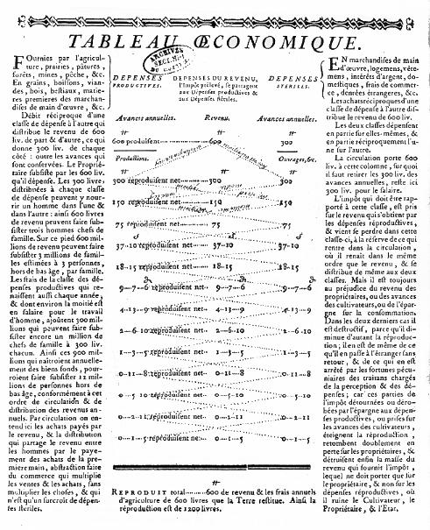

Slide 6
Key concepts
Industries / sectors
We simplify the economy into a few sectors (e.g., Agriculture, Industry, Services).
Intermediate demand /consumption
Goods and services industries buy from each other as inputs for production (e.g., Industry buys electricity).
Final demand /uses = y
Households, government, investment, exports… i.e., purchases not used as inputs for further production.
Total output = x
How much each industry produces (and sells) in total: to other industries + to final demand.

Slide 7
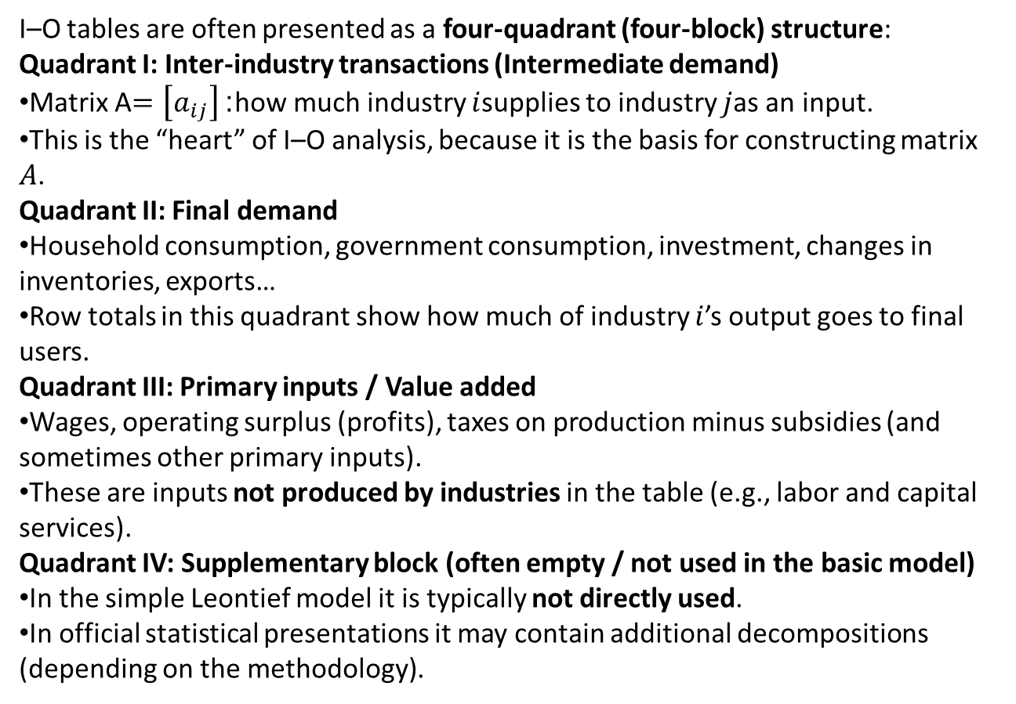
I–O tables are often presented as a four-quadrant (four-block) structure:
Quadrant I: Inter-industry transactions (Intermediate demand)
Matrix A$=\left[a_{ij}\right]$: how much industry $i$supplies to industry $j$as an input.
This is the “heart” of I–O analysis, because it is the basis for constructing matrix $A$.
Quadrant II: Final demand
Household consumption, government consumption, investment, changes in inventories, exports…
Row totals in this quadrant show how much of industry $i$’s output goes to final users.
Quadrant III: Primary inputs / Value added
Wages, operating surplus (profits), taxes on production minus subsidies (and sometimes other primary inputs).
These are inputs not produced by industries in the table (e.g., labor and capital services).
Quadrant IV: Supplementary block (often empty / not used in the basic model)
In the simple Leontief model it is typically not directly used.
In official statistical presentations it may contain additional decompositions (depending on the methodology).

Slide 8
Input-output model
Each element/industry act as supplier and consumer/user.
 |  | Industries/elements as users/consumers | Final uses | Final uses total | Used resources total/total outputs
 |  | 1, 2, … n | 1, 2, … h
Industies/ elements as suppliers | 1 2 : n | 1st quadrant Intermediate consumption x_{ij} | 2nd quadrant Final uses y_{il} | Y_{i} | X_{i}
Value added | 1 2 : n | 3rd quadrant Compensation of employees, operating surplus, taxes, cfc z_{kj}
Total output Import
Total supplies/inputs |  | X_{j}
See: SIOT
Notes:
Final uses:
export, GFCF, final consumption expenditures
Output vs outputs

Slide 9
Distribution equations
x_{i} is output of the industry
x_{ij} the part of output of industry i that is the part of input of industry j
y_{i} the part of output of industry i sold to final demand
z_{k} k^{th} element of third quadrant

Slide 10
Example (I): Gluttony Ltd.
 | Brewery | Butcher | Greengrocer | Restaurant | Final production/uses | Total uses/ outputs
Brewery | 10 | 5 | 2 | … | … | 100
Butcher | … | 10 | 2 | 45 | 18 | …
Greengrocer | 2 | … | … | 15 | 5 | 30
Restaourant | 5 | … | 1 | 5 | 184 | …
Wages | 5 | … | 3 | 4
Material inputs | … | 15 | 3 | 15
EBIT | 53 | 39 | 13 | 56
Total inputs | … | 80 | … | 200
Millions CZK
Complete the table!

Slide 11
Distribution equations
Input-output coefficients
a_{ij} … number of units of industry i required to produce one unit of industry j
Construct the coefficient matrix A for our example!

Slide 12
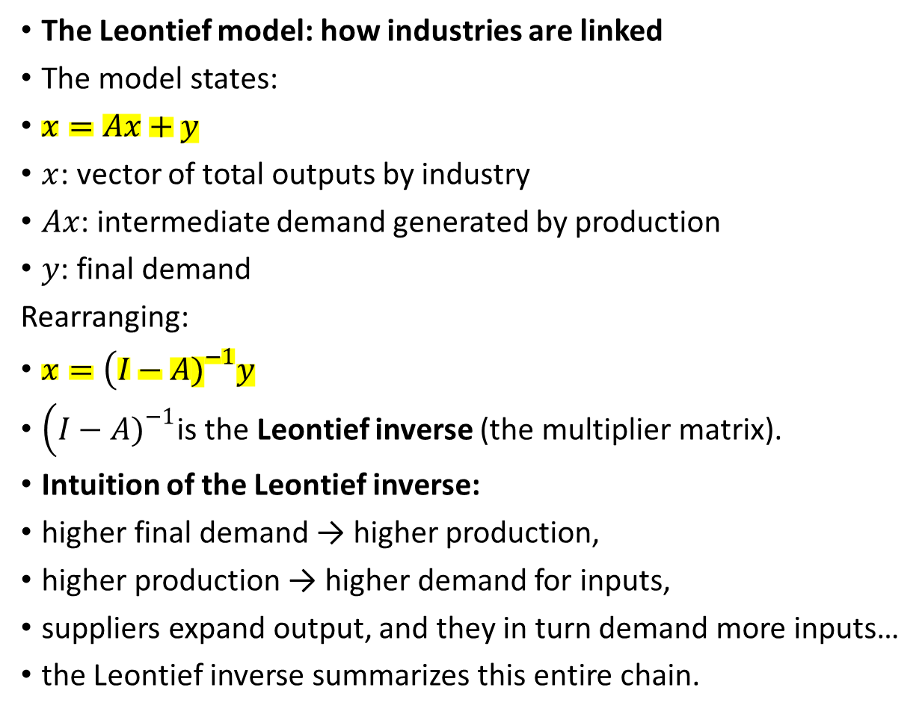
The Leontief model: how industries are linked
The model states:
$x=Ax+y$
$x$: vector of total outputs by industry
$Ax$: intermediate demand generated by production
$y$: final demand
Rearranging:
$x=\left(I−A{\left.)\right.}^{−1}y\right.$
$\left(I−A{\left.)\right.}^{−1}\right.$is the Leontief inverse (the multiplier matrix).
Intuition of the Leontief inverse:
higher final demand → higher production,
higher production → higher demand for inputs,
suppliers expand output, and they in turn demand more inputs…
the Leontief inverse summarizes this entire chain.

Slide 13

Distribution equations
x = Ax + y
z = Mx
x - Ax = y
y = (I - A)x
x = (I - A)⁻¹y
What does $\left(I−A{\left.)\right.}^{−1}\right.$mean?
It’s the Leontief inverse (multiplier matrix):
captures direct and indirect effects,
indirect effects = suppliers of suppliers, etc.
Notes:
Slovník MS EXCEL http://o-excelu.blogspot.com/p/cesko-anglicky-slovnik-funkci-excelu.html
MS EXCEL:
Matrix multiplication … =MMULT()
Scalar/Dot product … =SUMPRODUCT()
Matrix inversion … =MINVERSE()

Slide 14
Example:
Gluttony Ltd. could extend the production capacity of brewery to 120 (x₁‘ = 120) – what final production could be expected?
Gluttony Ltd. could conclude the sales of butchery (y₂‘ = 35) – how could be the total production capacity extended?

Slide 15

Price indices
…index for each element of third quadrant
Example:
Prices of material inputs increased by 10% for greengrocer and by 20% for restaurant, what is production price change?
ˆ … Diagonal matrix
I_{p} … Price index for industry production
I_{a} … Price index for wages
I_{m} … Price index for material inputs
I_{e} … Price index for EBIT
W … Vector of wages
M … Vector of material inputs
E … Vector of EBIT
Notes:
MS EXCEL:
Matrix transposition … =TRANSPOSE()

Slide 16
Discussion and limitations
Strengths:
clear, quantitative, great for “chain effects.”
Limitations (simple explanation):
fixed technology (A is constant),
basic model ignores price adjustments,
no explicit capacity constraints,
often static (single year/period).

Slide 17
Thank you for your attention.

